Slide 1




Master Degree in Embedded Computing Systems
Code generation for
Multi-Core Embedded System
with mix-critical applications
Supervisors:
Prof. Marco Di Natale
Prof. Giorgio C. Buttazzo
Candidate:
Pasquale Antonante
Pisa, May 2017
Notes:
Buon pomeriggio, il lavoro di tesi che vi presento riguarda la generazione di codice per sistemi multicore con applicazioni con mix-critical.
È un lavoro svolto alla UTRC di Cork con la supervisione del Prof. Di Natale

Slide 2
Motivation
Objectives
V
Model-Based Design
Develop a Model-Based Design Framework
Mix-Criticality
Support the design and Implementation of mix-critical application
Multi-Core
Evaluate Multi-Core in Avionics use-cases
Virtualization
Evaluate the use of virtualization for mix-critical systems
Embedded Multi-core Systems for Mixed-Criticality Applications in Dynamic and Changeable Real-Time Environments – ARTEMIS EMC²
Partners
Countries
Budget
101 Partners of Embedded Industries
16 European Countries
~ 94 M€
Notes:
Il lavoro che ho svolto è stato finanziato dal progetto EMC2 il quale aveva questi obiettivi…

Slide 3
Motivation
Contributions
Framework for optimized partitioning, allocation and scheduling of tasks on multi-core systems.
Enable Code Generate from Mix-Critical models.
Model-Based Design
Enable model-based design development
Isolation
Ensure Isolation among different criticality levels
Optimization
Automatic partitioning, allocation and scheduling optimized for multi-core
Code Generation
Automatic Code Generation from the model
Notes:
Il contributo che ho dato, sia nel progetto che più in generale è lo sviluppo di un framework...
...

Slide 4
Motivation
Multi-Core Embedded Systems
Increasing need of integrated functionality
Increasing need of processing power
Multi-Core Commercial-off-the-Shelf
More processing power
Reduced Size, Weight and Power (SWaP)
Unified Memory Model Architecture
Simplify the network topology
Complexity of certification
Notes:
La motivazione ch giustifica la ncessità di questo framework è …..

Slide 5
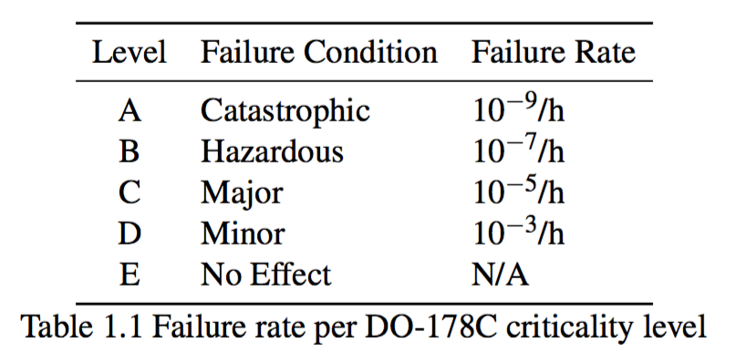
Motivation
Mix-Criticality
In Avionics:
DO-178C: considers the entire software life-cycle and provides a basis for avionic systems certification.
ARINC-653: software specification for safety-critical real-time operating systems.
Certification authorities define
Criticality Levels
Robust Partitioning (ARINC-653)
“The objective of Robust Partitioning is to provide the same level of functional isolation as a federated implementation."
Notes:
Le autorità per la certificazione….

Slide 6
Motivation
Objectives
V
Model-Based Design
Develop a Model-Based Design Framework
Mix-Criticality
Support the design and Implementation of mix-critical application
Virtualization
Evaluate the use of virtualization for mix-critical systems
Multi-Core
Evaluate Multi-Core in Avionics use-cases

Slide 7

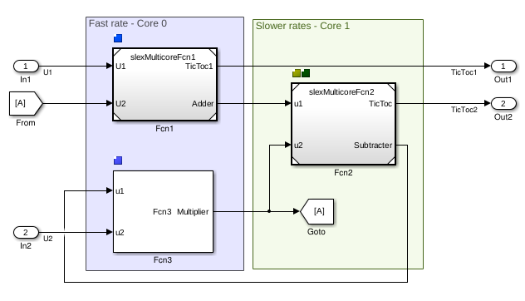
Frameworks and Tools
Model Based Design - Simulink
Model-Based Design Tool:
Mature Modelling and Simulation tool
Support Model Verification
Mature C/C++ Code Generator
Does not support mixed-criticality
Concurrent Workflow:
Support Multi-core allocation
Implicit/Explicit Partitioning for tasks only
Complex and not yet mature

Slide 8
Motivation
Objectives
V
Model-Based Design
Develop a Model-Based Design Framework
Mix-Criticality
Support the design and Implementation of mix-critical application
Virtualization
Evaluate the use of virtualization for mix-critical systems
Multi-Core
Evaluate Multi-Core in Avionics use-cases

Slide 9
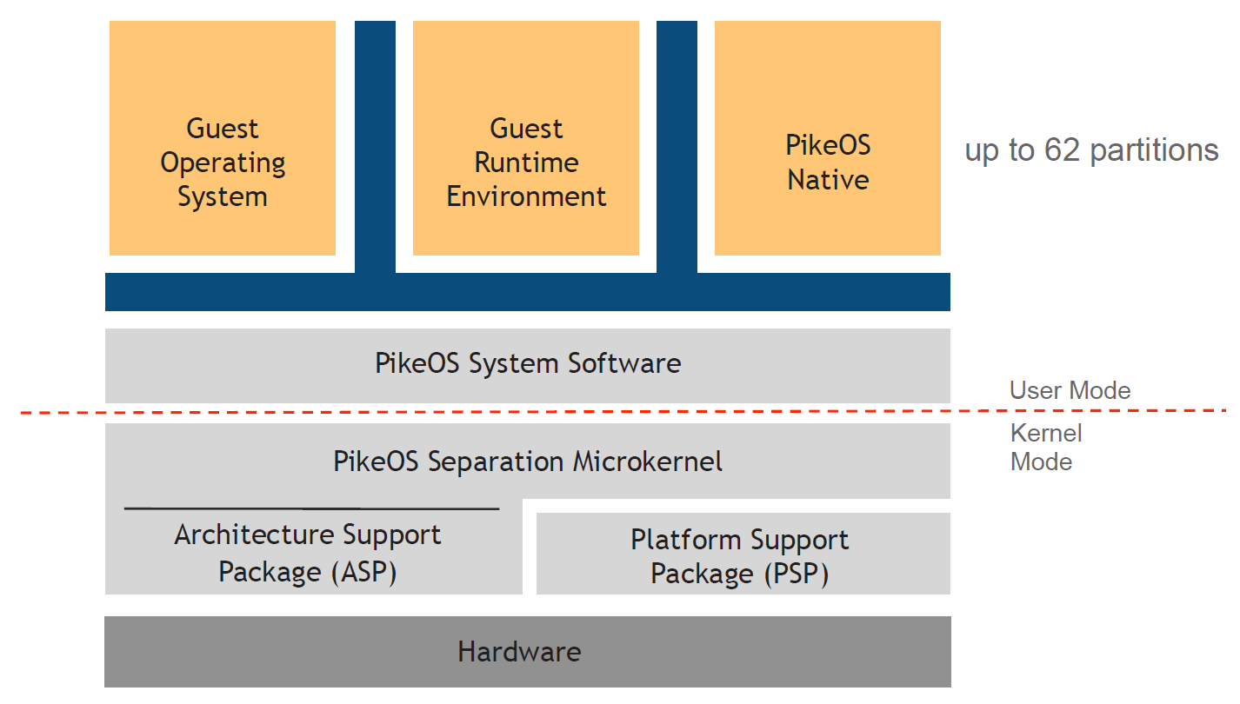
Frameworks and Tools
Hipervisor - PikeOS
PikeOS at glance:
Micro-Kernel based RTOS
Hypervisor
Separation Kernel
Trusted, Certified
DO-178B/C (avionics)
ARINC-653 (avionics)
IEC 61508 (industrial)
EN 50128 (railways)
ISO 26262 (automotive)
IEC 62304 (medical)
Multi-core support
PikeOS System Architecture

Slide 10

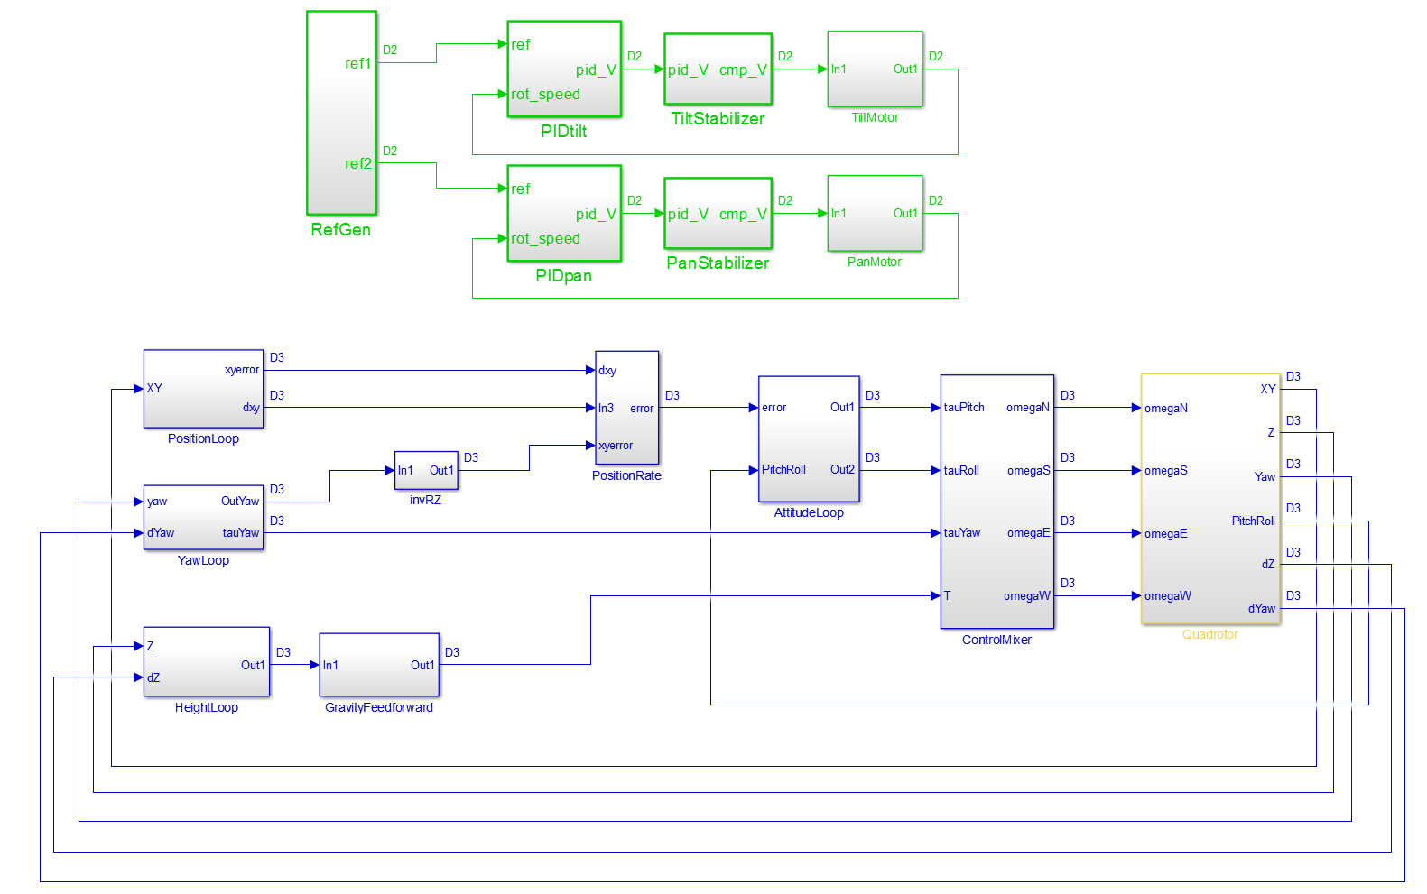
Scheduling and Allocation
Allocation and Scheduling Steps
Functional Model
Partitioning
Intra-Partition Scheduling
Inter-Partition Scheduling
1. The task-set is extracted from the model as a DAG and enriched with the designer information
2. Partition are automatically generated using Task periods, Resource Usage and Criticality
3. A MILP opt. solution allocates and schedules tasks in every partition. Than priorities are assigned.
4. Partitions are then scheduled as if they were on a Single-Core (Bratley Algorithm)

Slide 11
Partitioning, Scheduling and Allocation
Functional Model Extraction
The Simulink API
via Matlab
Once the model simulation is satisfactory, the designer defines tasks using Simulink Subsystems, no spare blocks are allowed among subsystems.
Using Simulink API, a Direct Acyclic Graph (DAG) is extracted a functional representation of the model

Slide 12
Partitioning, Scheduling and Allocation
Process Configuration
The system designer specifies:
WCET for each task
Criticality level of each task
Resources used by each task
Number of available Cores
Once ready, the Scheduling Optimization can be started

Slide 13
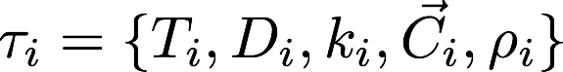
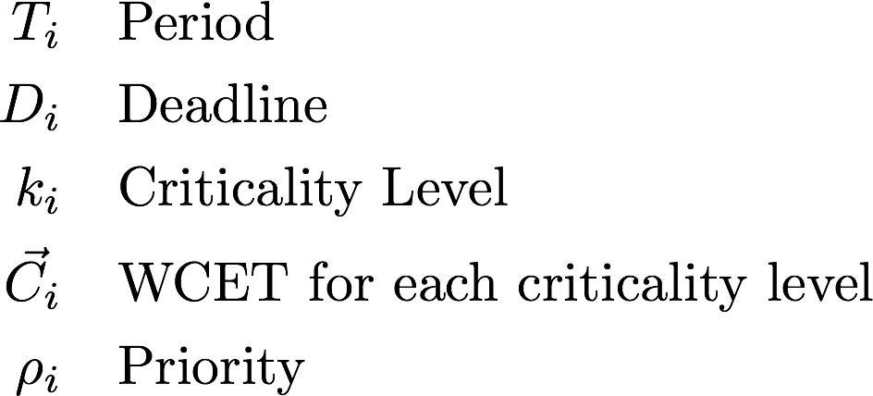
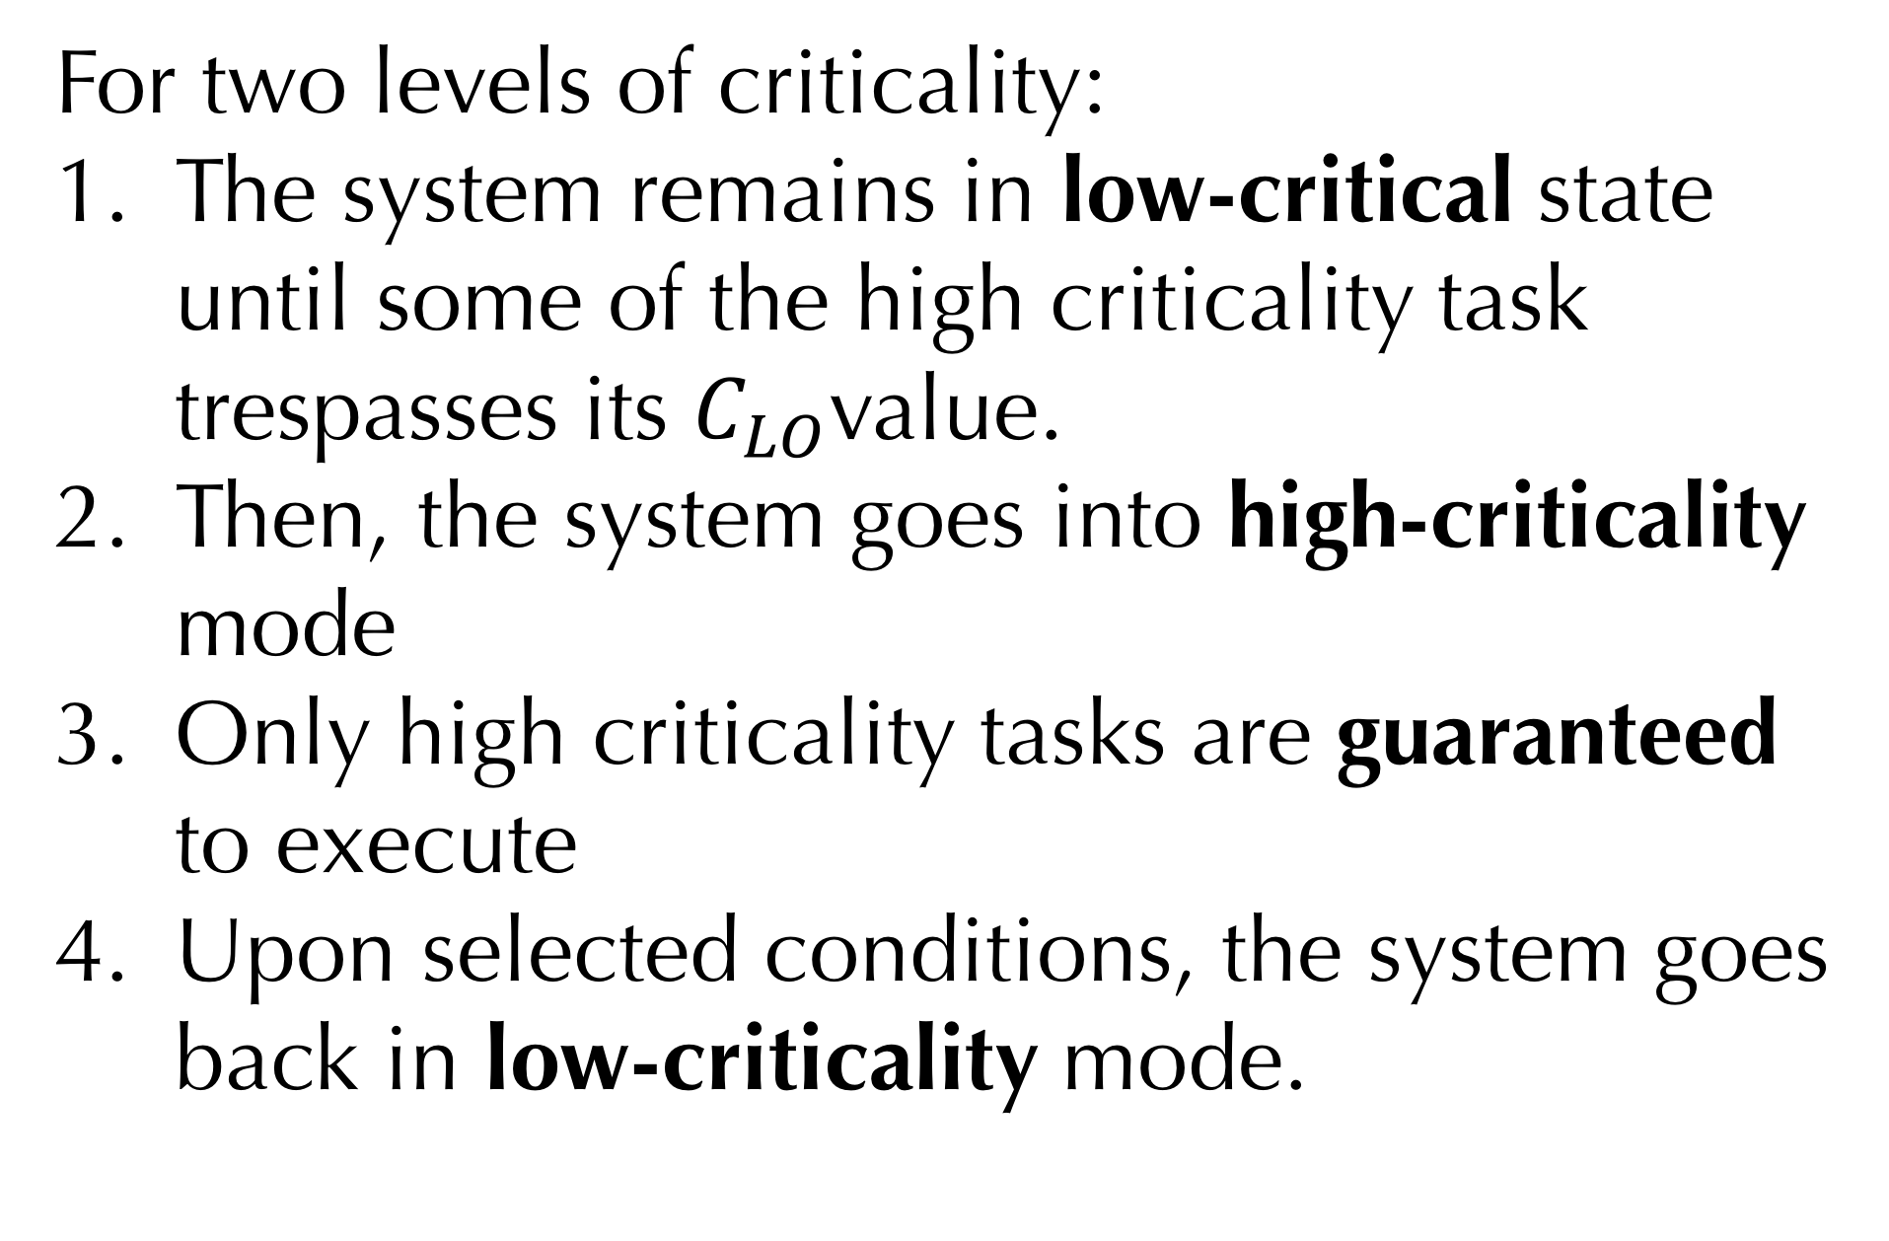
Partitioning, Scheduling and Allocation
Scheduling and Allocation for Mix-Criticality
Traditional model:
Typical scheduler policy:
For two levels of criticality:
The system remains in low-critical state until some of the high criticality task trespasses its $C_{LO}$value.
Then, the system goes into high-criticality mode
Only high criticality tasks are guaranteed to execute
Upon selected conditions, the system goes back in low-criticality mode.

Slide 14
Partitioning, Scheduling and Allocation
Global vs Partitioned Scheduling
Global:
Partitioned:
Better CPU usage
Better isolation
Lower Average Response time
More determinism
Easy to implement
Cannot exploit unused capacity
Poor separation
NP-Hard

Slide 15


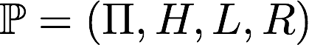
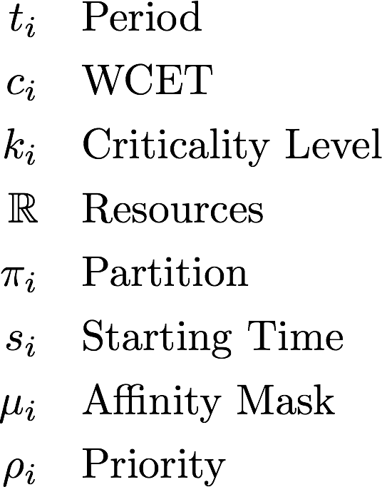
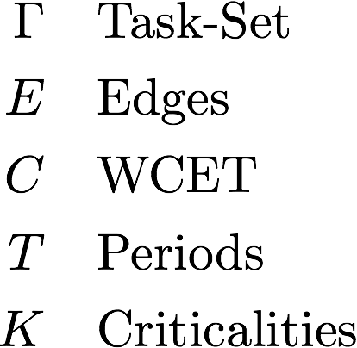
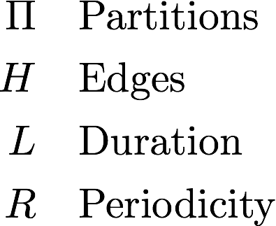
Partitioning, Scheduling and Allocation
Problem Formulation
Tasks:
Task-set DAG:
Partitions DAG:
Notes:
t_i & \quad\text{Period}\\
c_i & \quad\text{WCET}\\
k_i & \quad\text{Criticality Level}\\
\mathbb{R} & \quad\text{Resources}\\
\pi_i & \quad\text{Partition}\\
s_i & \quad\text{Starting Time}\\
\mu_i & \quad\text{Affinity Mask}\\
\rho_i & \quad\text{Priority}\\

Slide 16
Code Generation
Execution Entities
Once a feasible schedule is obtained, the Code Generation can be started from the GUI
With respect to the PikeOS terminology:
Each Subsystem is a Thread
Each Partition is a Process inside a Resource Partition
Each Time Partition contains a single Resource Partition
PikeOS Execution Entities
PikeOS Execution Entities

Slide 17
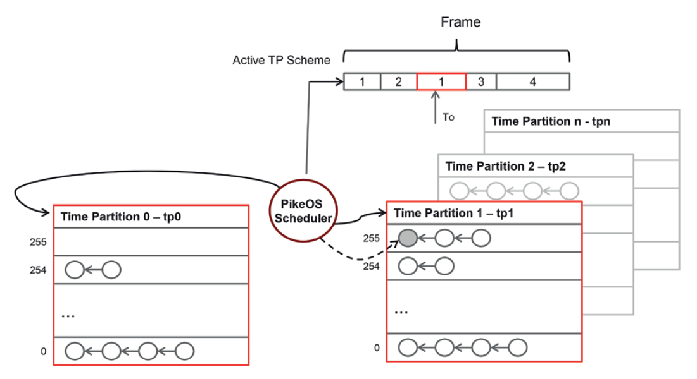
Code Generation
PikeOS Real-Time Scheduling
RP-1
TP-1
RP-2
TP-2
RP-3
TP-3
RP-0
TP-0
Major Time Frame
Active Partition
TP-1
TP-2
TP-3
Background Partition
TP-0

Slide 18
Code Generation
Code Generation Process
Comm. Adaptation
Subsystem Gen.
Native Processes Gen.
OS Conf. Snippets
1. Intra-Partition comm. are adapted to the SW configuration. In/Out port that are at the edge of two different partitions must be replaced by the operations on a Sampling port.
Achieved by a Custom Blockset.
2. Each subsystem is generated by Simulink.
A description (XML) file is also generated for each subsystem, it describes the code interface.
The process is driven by a Custom System Target File.
3. Each XML description file is parsed and a Native PikeOS Process is generated for each Partition.
Achieved by a custom TLC file.
4. PikeOS requires a static configuration. Several XML snippets are generated for the Integration Project.
Achieved by a custom TLC file.

Slide 19
Code Generation
Conclusions
Contribution:
Model-Based Design framework, supported by Simulink, for mix-criticality application in multi-core embedded system
Future Works - Scheduling
Improvements on the partitioning algorithm
Add automatic Worst-Case Execution Time Analysis
Formal verification to prove that hazardous states are never reached
Future Works – Code Generation
Add support to non-periodic tasks
Support Hardware-in-the-loop

Slide 20
References
[1] Vestal, Steve. "Preemptive scheduling of multi-criticality systems with varying degrees of execution time assurance." Real-Time Systems Symposium, 2007. RTSS 2007. 28th IEEE International. IEEE, 2007.
[2] Ernst, Rolf, and Marco Di Natale. "Mixed Criticality Systems—A History of Misconceptions?." IEEE Design & Test 33.5 (2016): 65-74.
[3] Global scheduling in multiprocessor real-time systems. Alessandra Melani, Retis.
[4] Artemis EMC2 European Project. http://www.artemis-emc2.eu/.
[5] Pikeos safe real-time scheduling. adaptive time-partitioning scheduler for en 50128 certi ed multi-core platforms. SYSGO Whitepaper.
[7] Marc Fumey Xavier Jean, Marc Gatti Guy Berthon. The use of multicore processors in airborne systems (mulcors), 2012. https://www.easa.europa.eu/ document-library/research-projects/easa20116.

